Slide 1




A Presentation
of
Minor Project (2160614)
ANPR-
Automatic Number Plate Recognition: using YOLO8
Branch : Information Technology
Session: Jan-June 2025
Presented by
Bhumika Lalwani (0901IT221019)
Faculty Mentor :
Prof. Vikas Sejwar

Slide 2
About the project
This project aims to develop an advanced Automatic Number Plate Recognition (ANPR) system using YOLOv8, a state-of-the-art object detection model. The system is designed to detect and recognize vehicle number plates in real-time, making it ideal for applications in parking lots, garages, and small businesses.
Key Features:
Real-time Vehicle Identification: Fast and accurate plate recognition.
Image Format Compatibility: Supports various formats like JPG, JSON, and more.
Altered Plate Handling: Capable of identifying tampered or fabricated plates.
Data Recording: Logs vehicle details for future reference and analytics.
Scalability: Easily adaptable for different environments and requirements.

Slide 3
Objectives
To train and fine-tune the YOLOv8 object detection model specifically for identifying vehicle license plates in Indian traffic and parking scenarios.
To integrate a lightweight OCR module (EasyOCR) that extracts and deciphers the alphanumeric characters from detected license plates.
To test the system under various real-world conditions, such as day/night, front/angled views, blurred or obscured plates.
To ensure low-latency, real-time performance for live camera or video stream inputs.
To make the system modular and compatible with integration into surveillance infrastructure and embedded edge devices.
To explore exportable formats (e.g., ONNX) for deploying the model on mobile and IoT devices in future phases.

Slide 4
Tools and Technologies Used
Programming Language: Python 3.10
Deep Learning Framework: PyTorch
Object Detection Model: YOLOv8 (Ultralytics)
OCR Engine: EasyOCR
Computer Vision: OpenCV
Dataset Labeling Tools: LabelImg, Roboflow
Training Environment: Google Colab Pro (GPU) / Local NVIDIA RTX 3060
Model Conversion (planned): ONNX, TensorRT for embedded optimization

Slide 5
Real Life Applications
Event Security and VIP Tracking
Urban Traffic Analytics
Fleet and Logistics Monitoring
Campus and Industrial Zone Access Control
Border Security and Entry Control
Law Enforcement and Traffic Violation Detection
Toll Booth Automation
Smart Parking Management

Slide 6
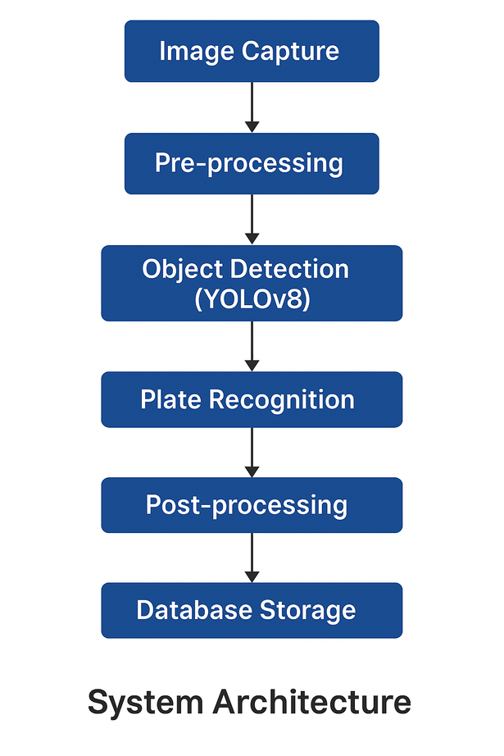
System Architecture
Image Capture: Cameras capture vehicle images in various formats (JPG, JSON).
Pre-processing: Image enhancement (scaling, denoising) for better recognition accuracy.
Object Detection (YOLOv8): YOLOv8 model detects the vehicle and number plate in real-time.
Plate Recognition: OCR (Optical Character Recognition) extracts the number from the plate.
Post-processing: Handles plate formatting and validation.
Database Storage: Logs vehicle data (plate, timestamp, location) for future reference.
User Interface: Displays recognized data in a user-friendly dashboard for monitoring.

Slide 7
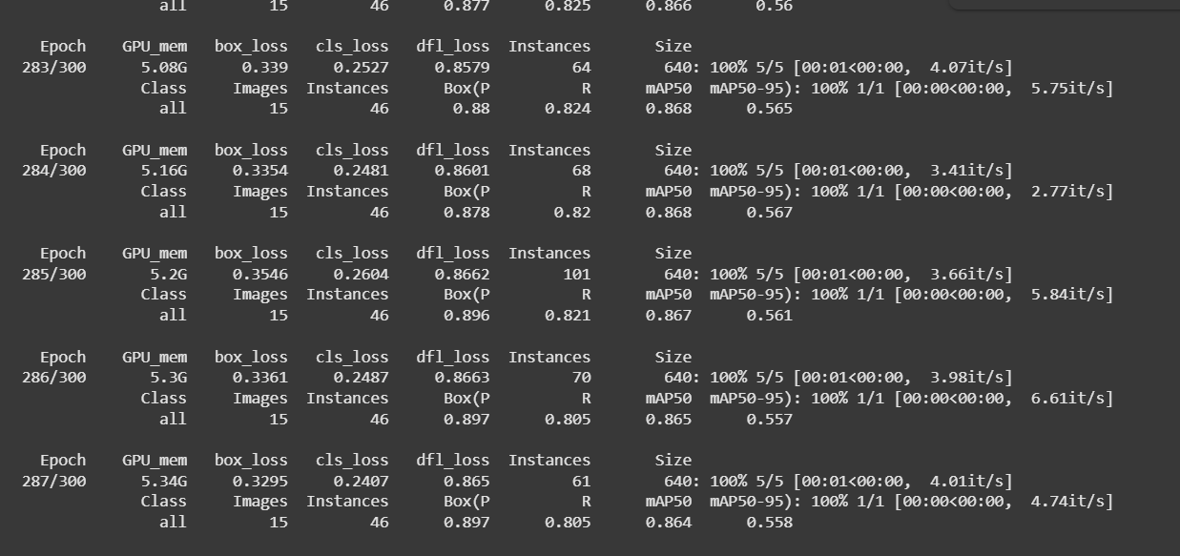
Model Training

Slide 8
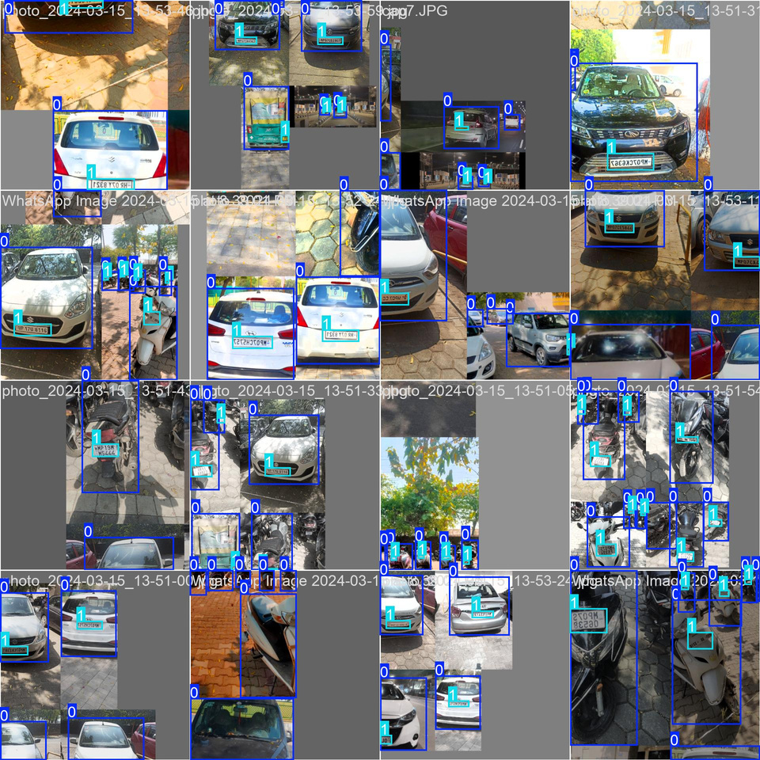
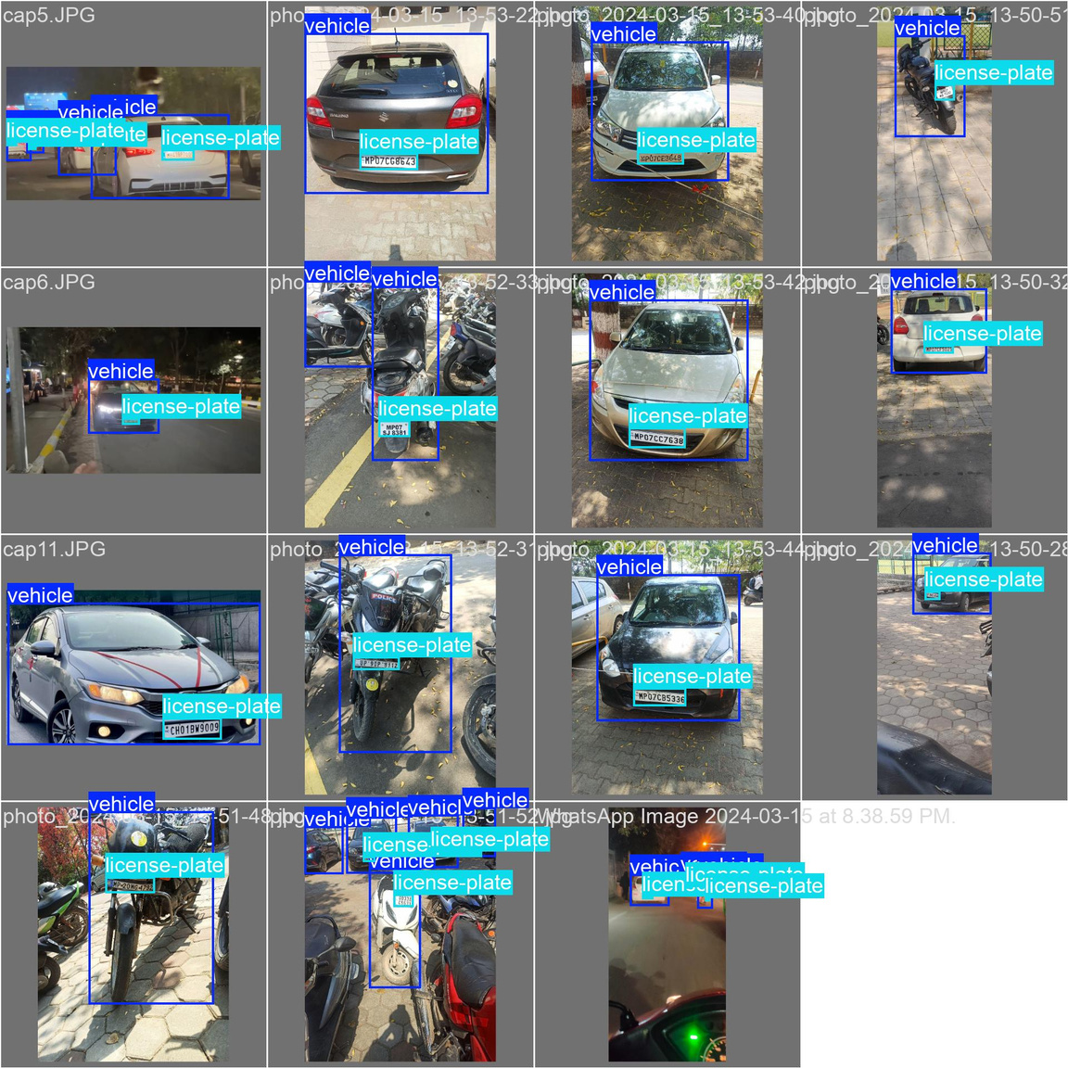
Output:
Training Data:

Slide 9
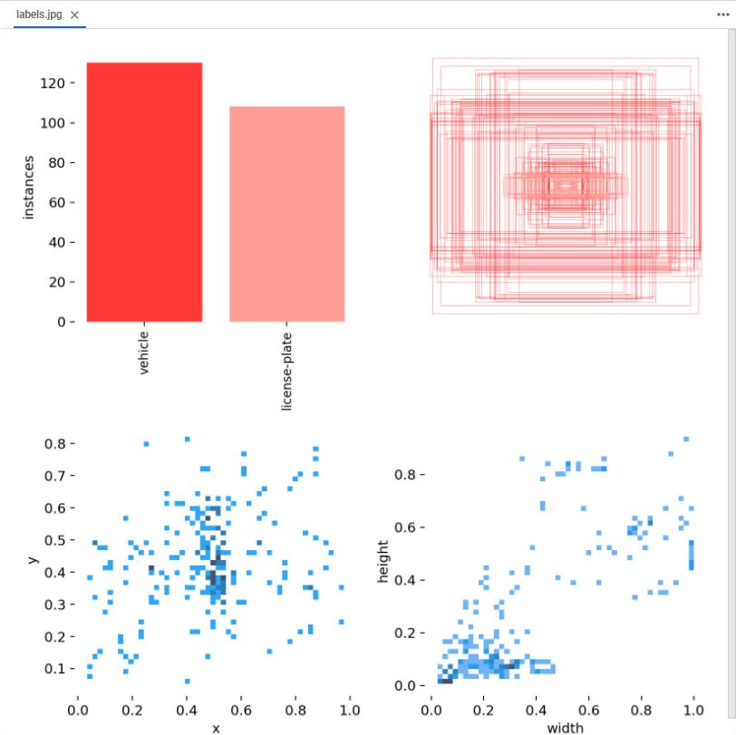
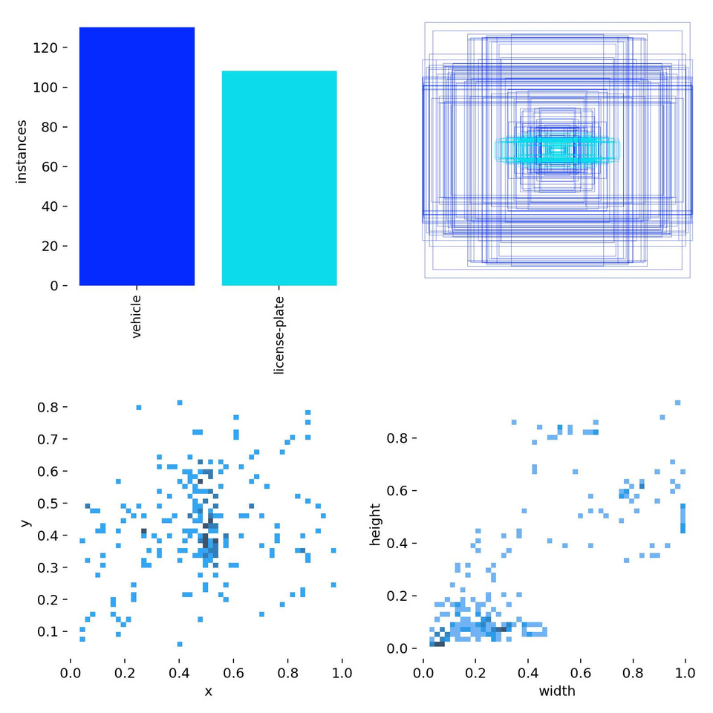
Output metrics:

Slide 10
Challenges & Limitations
Plate Quality: Difficult to read damaged, dirty, or non-standard plates.
Environmental Factors: Weather and lighting affect performance; varying angles and speeds complicate detection.
Accuracy: False positives/negatives, especially with modified plates or low-resolution images.
Speed: High traffic and large data volumes may slow processing.
Legal Concerns: Privacy issues and data protection compliance.
Global Plate Variations: Diverse plate formats across regions require extensive model training.

Slide 11
Future Scope
Integration with IoT and Smart Cities: Real-time ANPR data can support automated toll collection, traffic management, and smart parking systems.
Cross-Platform Deployment: Extend functionality to mobile and edge devices for portable enforcement and monitoring.
Enhanced Accuracy with AI: Use advanced deep learning models for better recognition under poor lighting, motion blur, or occlusion.
Multilingual and Global Plate Support: Train on diverse datasets to support plates from different regions and countries.
Real-Time Alert Systems: Integrate with law enforcement to flag stolen or blacklisted vehicles instantly.
Cloud-Based Analytics: Store and analyze large-scale ANPR data for trend forecasting, heatmaps, and security insights.

Slide 12
Conclusion
The ANPR system effectively automates the detection and recognition of vehicle number plates using advanced deep learning techniques like YOLOv8 and OCR. It enhances operational efficiency, ensures reliable vehicle monitoring, and addresses security concerns in real-time applications such as parking management and restricted access zones. Despite challenges like environmental conditions and plate tampering, the system demonstrates strong potential for scalability and integration across diverse domains. This project lays the foundation for future improvements in smart surveillance and intelligent transport systems.

Slide 13

Thank
You
Presented b: Bhumika Lalwani

